Slide 1

Database Security
Best Practices & Recommendations
Erick Kamamba| UDOM | 2/2/2021

Slide 2
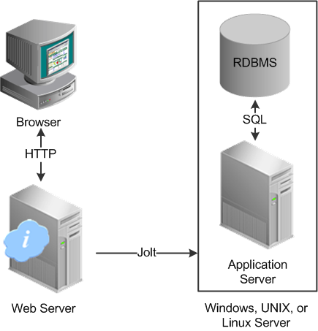
What is database security?
Collective measures used to protect and secure a database or database management software from illegitimate use and malicious cyber threats and attacks
Procedures are aimed at protecting not just the data inside the database, but the database management system and all the applications that access it from intrusion, misuse of data, and damage
Enforces security on all aspects and components of databases
Data
Database Server
Database Management Systems (DBMS)
Application

Slide 3
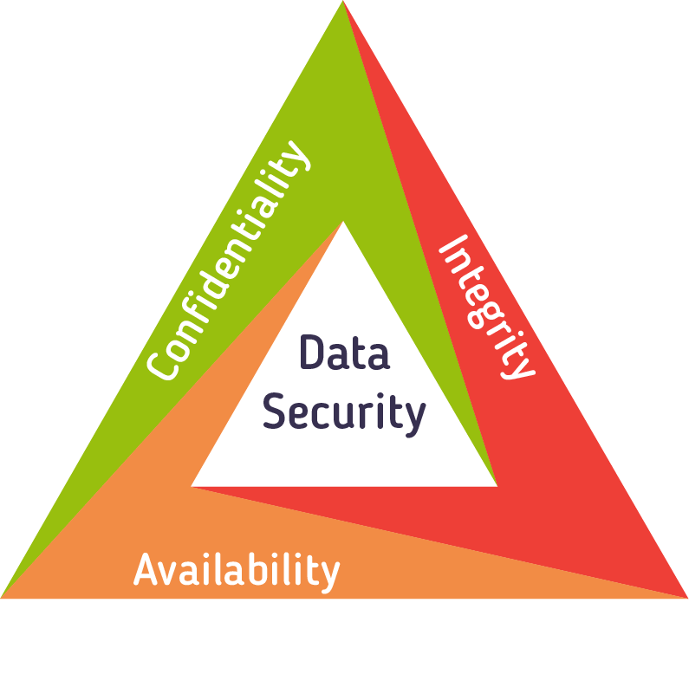
Why is database security important?
Ensuring business continuity
Minimizing financial damage
Loss of intellectual property
Brand reputation damage
Penalties and fines

Slide 4
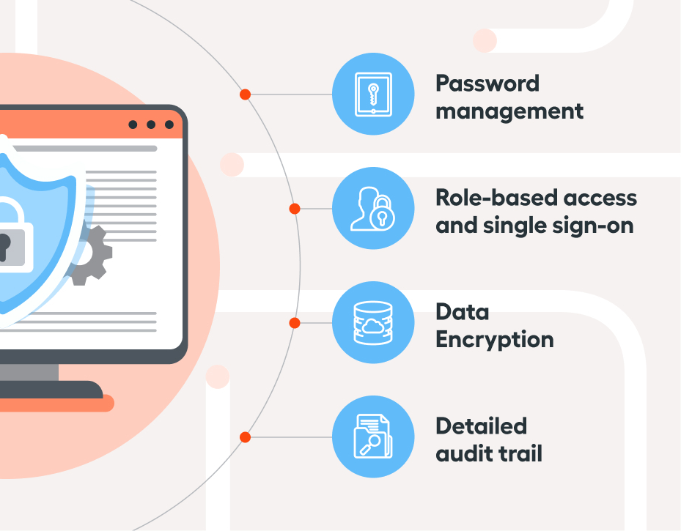
Database Security Controls
Audit and Monitor Database Activity
Manage Database Access
Minimize Value of Your Database
Data Encryption
Database Load/stress testing and capacity testing
System & Database Hardening
Use Web Application and Database Firewalls
Physical security of the database server and backup equipment

Slide 5
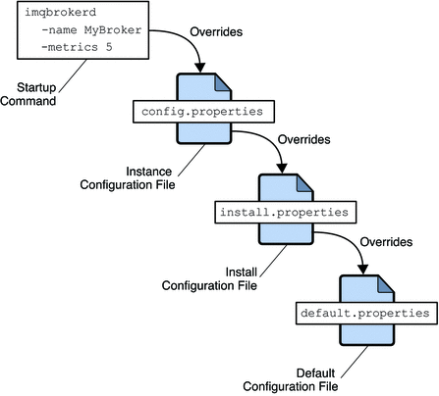
Minimize Value of Your Database
Ensure that you are not storing any confidential information that doesn’t need to be there
Delete any information that you don’t need
Data that must be retained for compliance or other purposes can be moved to more secure storage – perhaps offline
Delete System configuration/installation files (such as the MySQL history file ~/.mysql_history)

Slide 6
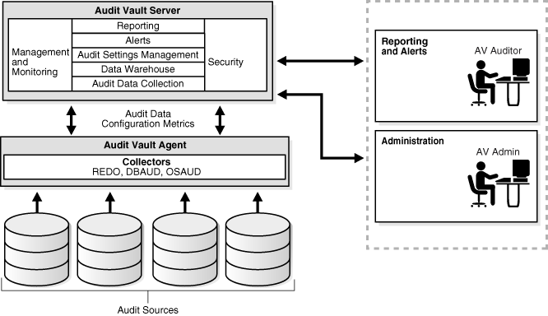
Audit and Monitor Database Activity
Monitoring logins (and attempted logins) to the operating system and database and reviewing logs regularly to detect anomalous activity
Helps to detect, deter, and reduce the overall impact of unauthorized access to your DBMS

Slide 7
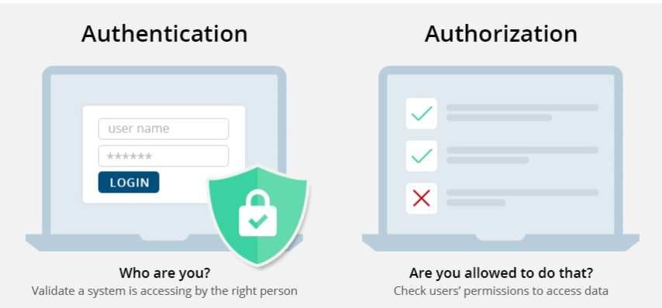
Manage Database Access
Aim for the least number of people possible to have access to the database
Administrators should have only the bare minimum privileges they need to do their job, and only during periods while they need access
The Access process can be automated
ensure standard account security procedures are followed
Strong passwords should be enforced
Password hashes should be stored encrypted
Accounts should be locked after X login attempts
A procedure should be put in place to ensure that accounts are deactivated when staff leave or move to different roles

Slide 8
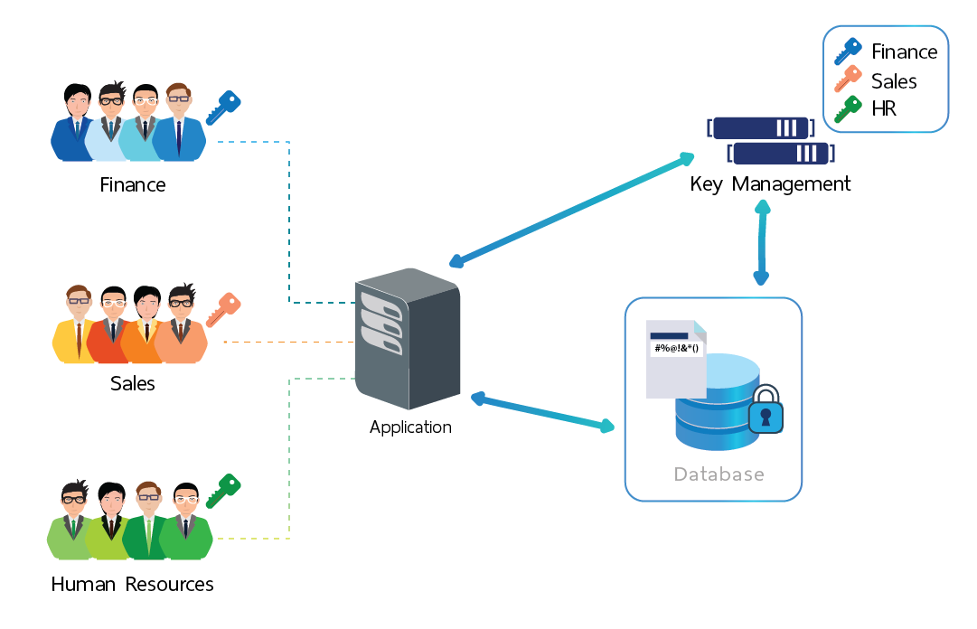
Data Encryption
Ensure that backup data is also encrypted and stored separately from the decryption keys
Ensure confidential data is encrypted in motion over your network

Slide 9
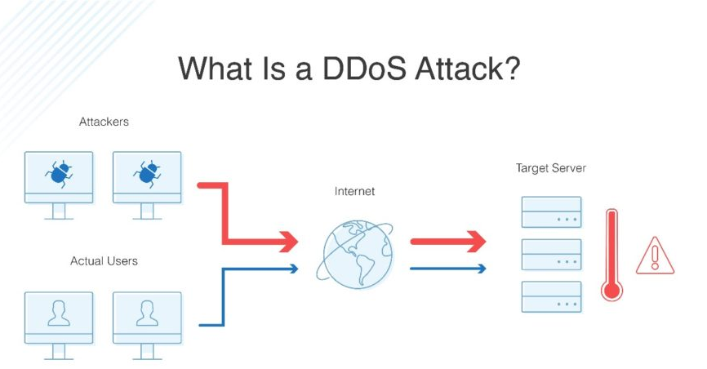
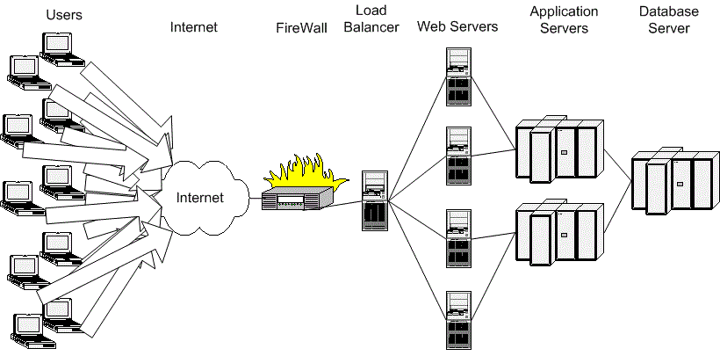
Database Load/stress and capacity testing
Ensure it does not crash in a Distributed Denial of Service (DDoS) attack or user overload

Slide 10
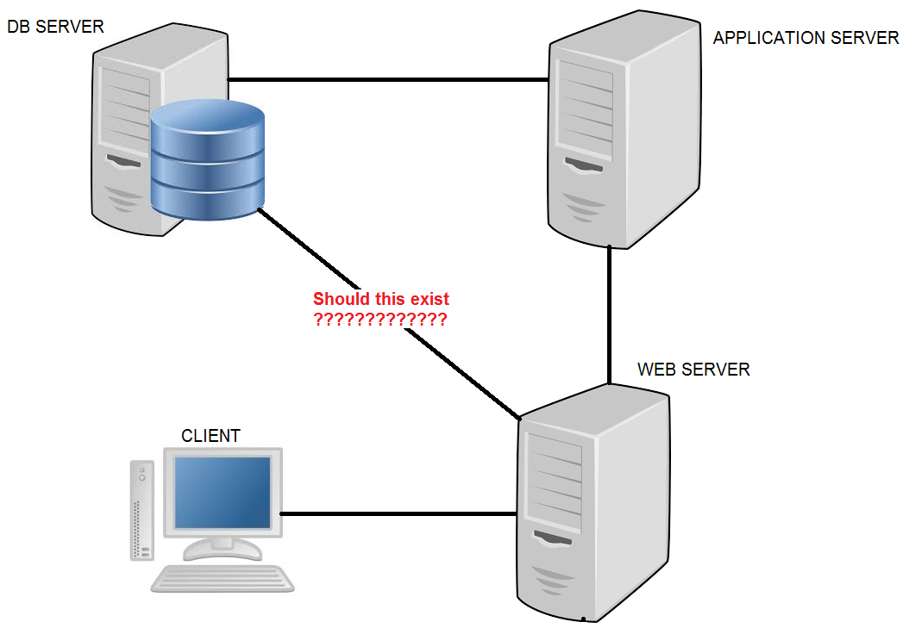
System & Database Hardening
Make sure you are running most up-to-date version of the database software with all database security patches installed to remove known vulnerabilities
Uninstall or disable any features or services that you don’t need to use
Change the passwords of any default accounts from their default values or delete them
Document and audit the hardened configuration

Slide 11
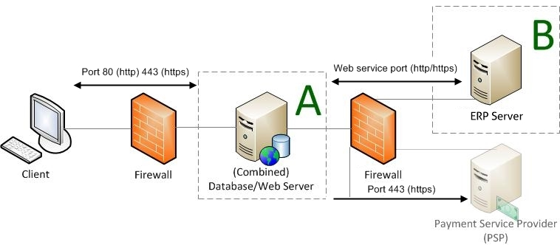
Use Web Application and Database Firewalls
Deny access to traffic by default
Allow only traffic coming from specific application or web servers
The firewall should also protect your database from initiating outbound connections unless there is a specific need to do so

Slide 12
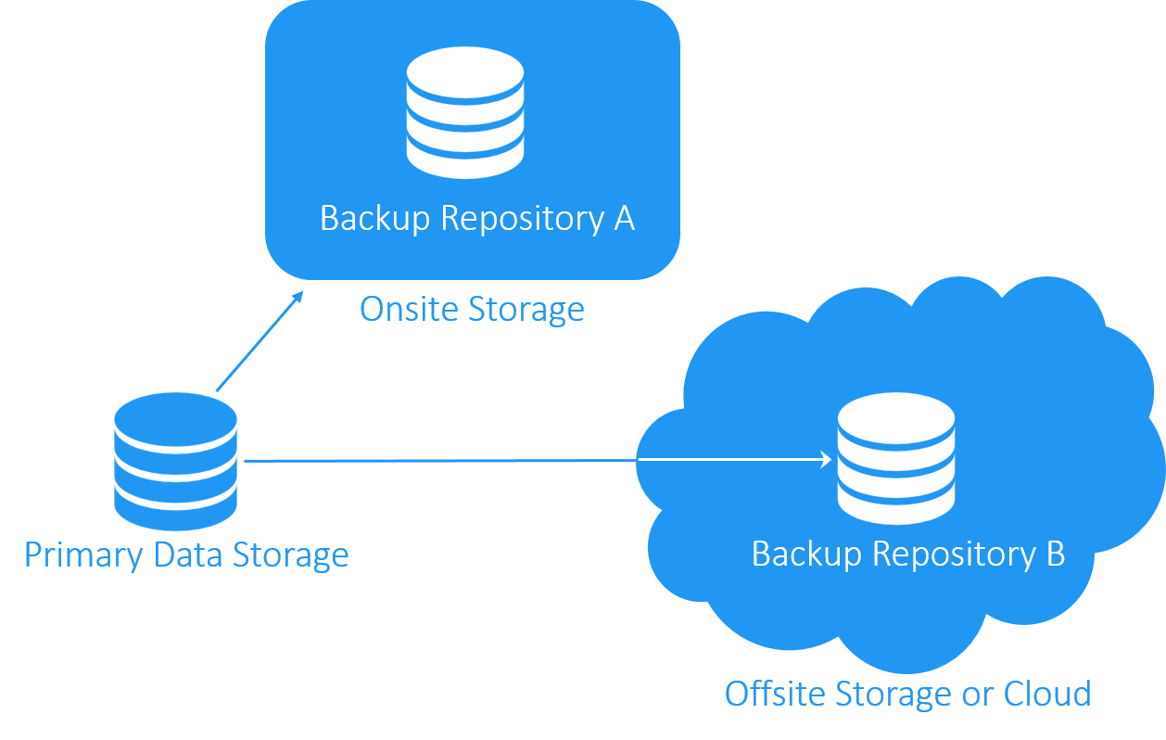
Physical Database Security
Keep your database server in a secure, locked environment with access controls in place
Database on a separate physical machine, removed from the machines running application or web servers
Natural disasters

Slide 13
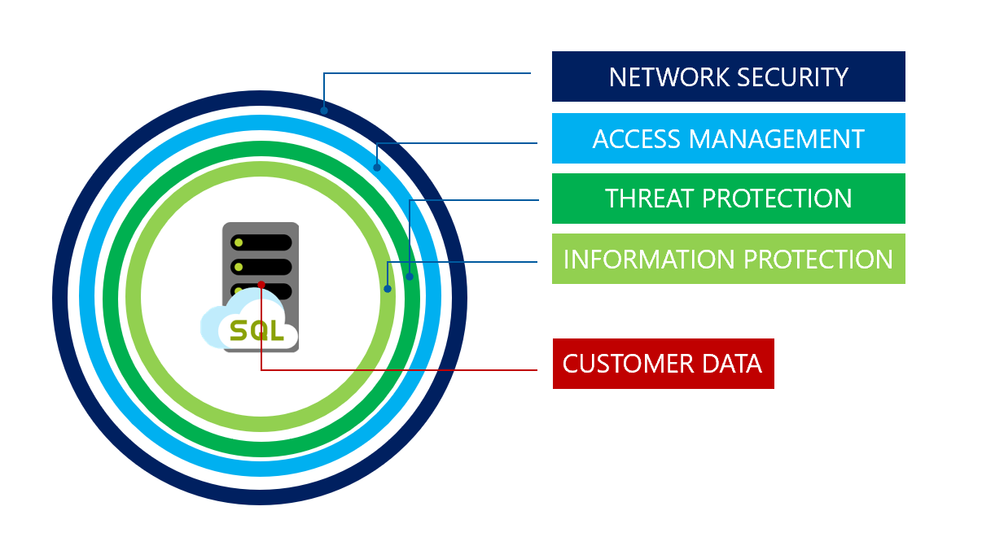
END

